Slide 1










INNOVATIVE SOLUTIONS
TO ADDRESS :
E-WASTE CRISES
Aligning with UN SDG 12: Responsible Consumption and Production

Slide 2
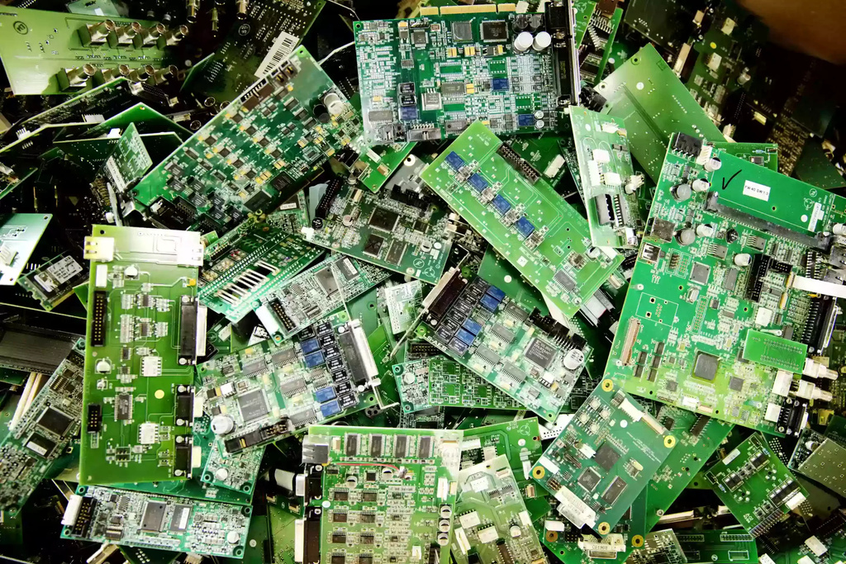
INTRODUCTION
E-waste refers to discarded electrical and electronic devices.
It poses significant environmental and health risks.
UN SDG 12 aims to reduce waste generation through prevention, reduction, recycling, and reuse.
Innovative and scalable solutions are needed to address this crisis.

Slide 3
UNDERSTANDING THE PROBLEM
50 million tons of e-waste are generated annually.
Only 20% of e-waste is formally recycled.
Toxic substances like lead, cadmium, and mercury contaminate the environment.
Limited consumer awareness and lack of infrastructure worsen the problem.

